Slide 1

Earthquake Magnitude Prediction with Seismic Nucleation Phase based on Machine Learning （初期破壊の機械学習による地震規模予測）

Slide 2
Contents
Introduction
Dataset Generation
Training Process
Results
Conclusions

Slide 3
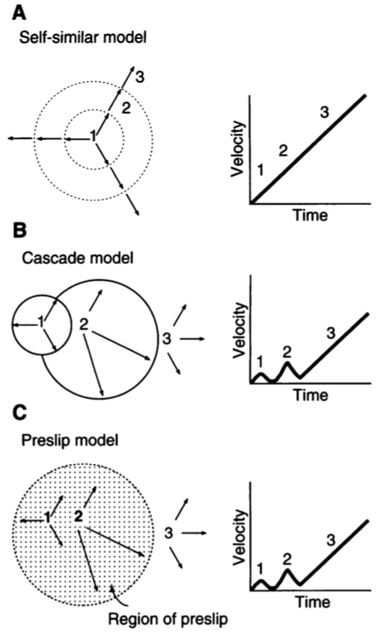
Introduction
Nucleation phase and debate between two models
Although the mechanism of earthquake rupture growing is still unknown, seismologists have proposed three models to explain it: self-similar model, cascade model, and nucleation (pre-slip) model. Since the self-similar model had been disproved, most of the controversies focus on the nucleation model and the cascade model.
Ellsworth, W. L., and G. C. Beroza. "Seismic evidence for an earthquake nucleation phase." Science 268.5212 (1995): 851-855.

Slide 4
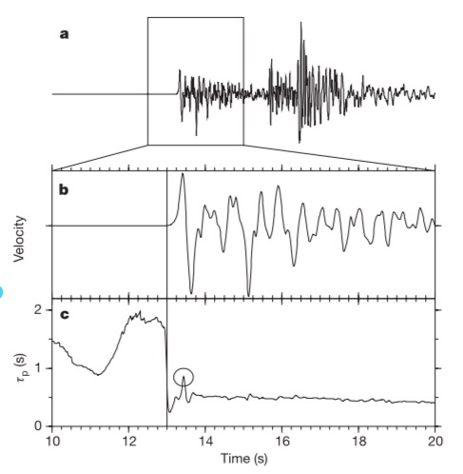
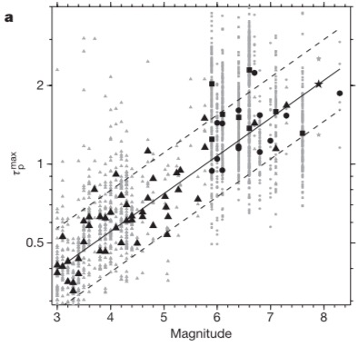
Introduction
Nucleation phase and debate between two models
Nucleation model
The nucleation model considers that earthquake starts at pre-slip, the propagation and power had been determined at the beginning.
Olson, Erik L., and Richard M. Allen. "The deterministic nature of earthquake rupture." Nature 438.7065 (2005): 212.

Slide 5
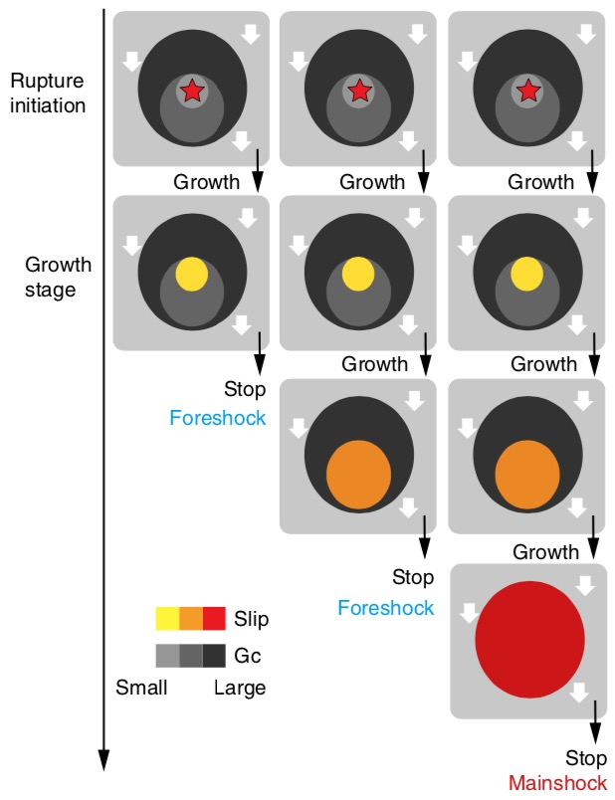
Introduction
Nucleation phase and debate between two models
Cascade model
The cascade model considers that earthquakes initiate at a small patch. Based on the geological conditions and the features of slip, it can grow up to a large earthquake or stop as a small earthquake.
Earthquake grow up like domino
Okuda, Takashi, and Satoshi Ide. "Hierarchical rupture growth evidenced by the initial seismic waveforms." Nature communications 9.1 (2018): 3714.

Slide 6
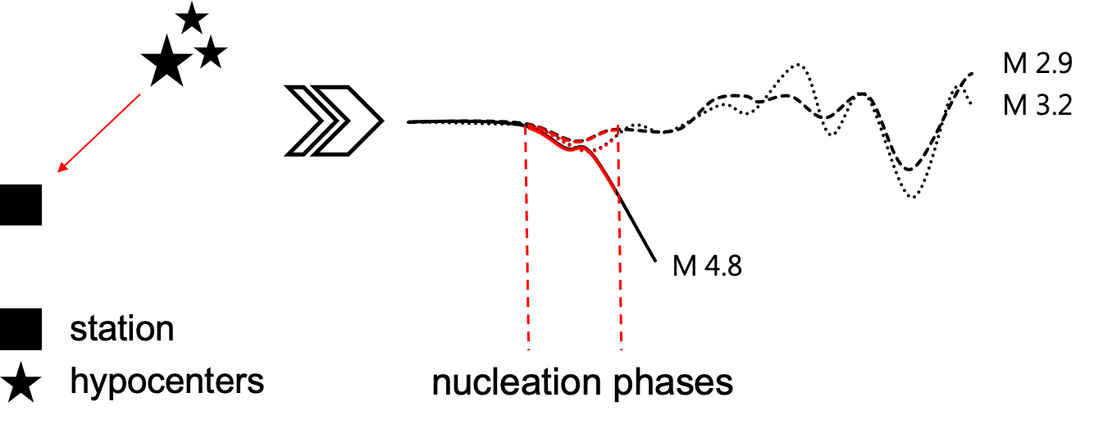
Introduction
Nucleation phase and debate between two models
Cascade model
If several hypocenters are close to each other and their waveforms are captured by a same seismometer, then no matter what their magnitudes are, their nucleation phases are sometimes similar.
Okuda, Takashi, and Satoshi Ide. "Hierarchical rupture growth evidenced by the initial seismic waveforms." Nature communications 9.1 (2018): 3714.
Small earthquake
Large earthquake

Slide 7
Introduction
Nucleation phase and debate between two models
Nucleation
model
start of failures is different
Possible to predict magnitude with nucleation phase
Cascade
model
start of failures is same
Impossible to predict magnitude with nucleation phase
Notes:
Here is the biggest difference between thiese two models

Slide 8
Introduction
Research Objectives
Nucleation phase theory
+
Machine Learning
positive
Nucleation
model
Predict magnitude with nucleation phase data
negative
Cascade
model

Slide 9
Dataset Generation
We do not have a ready-made dataset to analysis, and we need to build one by ourselves. Four kinds of data are used to build dataset.
JMA unified hypocenter catalog
Hypocenter origin time, location (latitude, longitude, and depth) and JMA magnitude information
NIED seismic station data
Hi-net seismic station location (latitude, longitude, and altitude) information
NIED Hi-net waveform data
Waveform recorded by Hi-net seismic stations
JMA arrival time data
Arrival time data of phases

Slide 10
Dataset Generation
Methods for extracting nucleation phase
We designed two kinds of method to extract nucleation phase in segments of waveform. Then we compare with the arrival time data to check their performance.
Method based on acceleration value
Method based on LTA/STA trigger algorithm

Slide 11
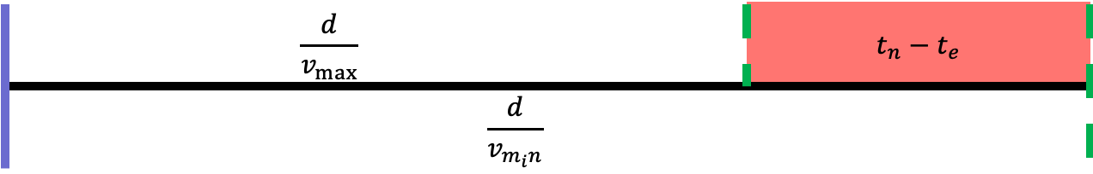
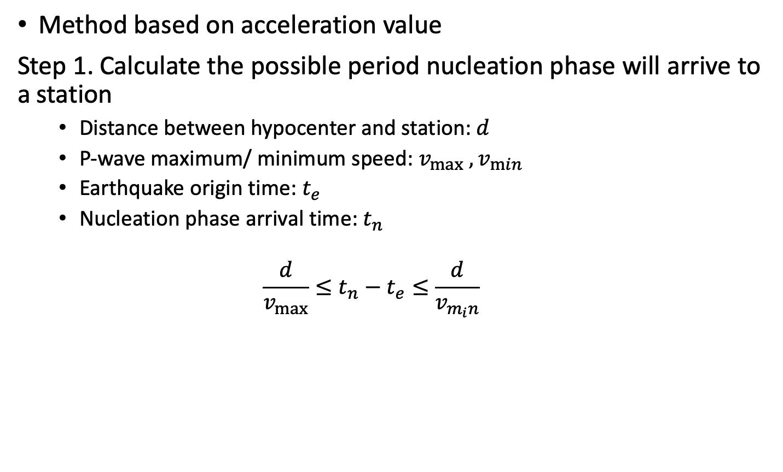
Dataset Generation
Method based on acceleration value
Step 1. Calculate the possible period nucleation phase will arrive to a station
Distance between hypocenter and station: $d$
P-wave maximum/ minimum speed: $v_{max} ,v_{min}$
Earthquake origin time: $t_{e}$
Nucleation phase arrival time: $t_{n}$
$$\frac{d}{v_{max}}≤t_{n}−t_{e}≤\frac{d}{v_{m_{i}n}}$$
Origin time
possible period

Slide 12
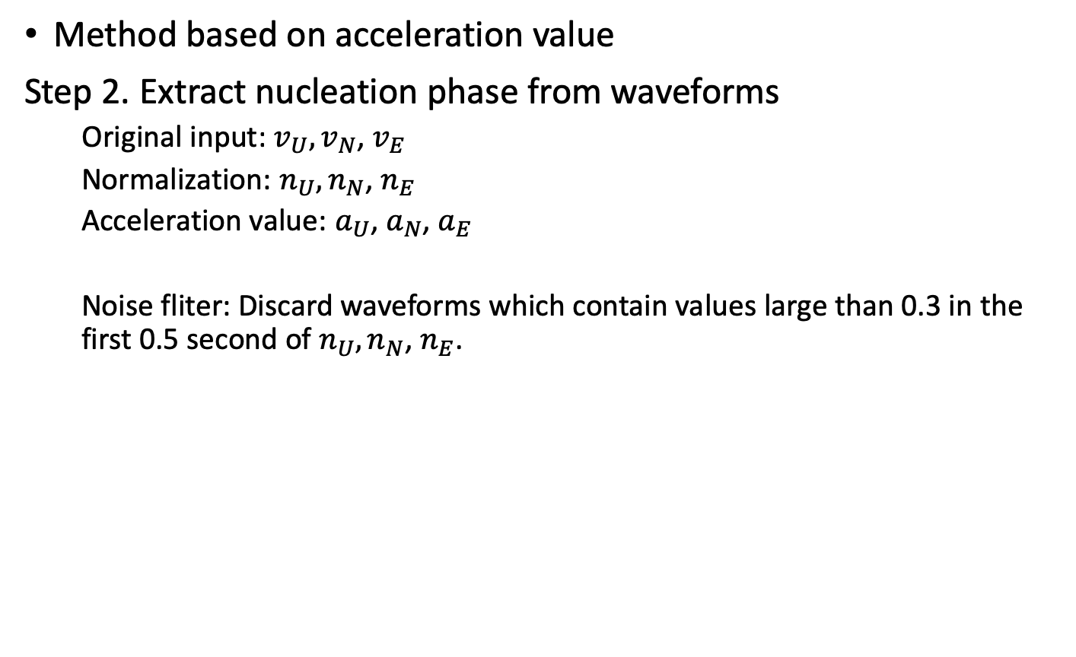
Dataset Generation
Method based on acceleration value
Step 2. Extract nucleation phase from waveforms
Original input: $v_{U},v_{N}$, $v_{E}$
Normalization: $n_{U},n_{N}$, $n_{E}$
Acceleration value: $a_{U}$, $a_{N}$, $a_{E}$
Noise fliter: Discard waveforms which contain values large than 0.3 in the first 0.5 second of $n_{U},n_{N}$, $n_{E}$.

Slide 13
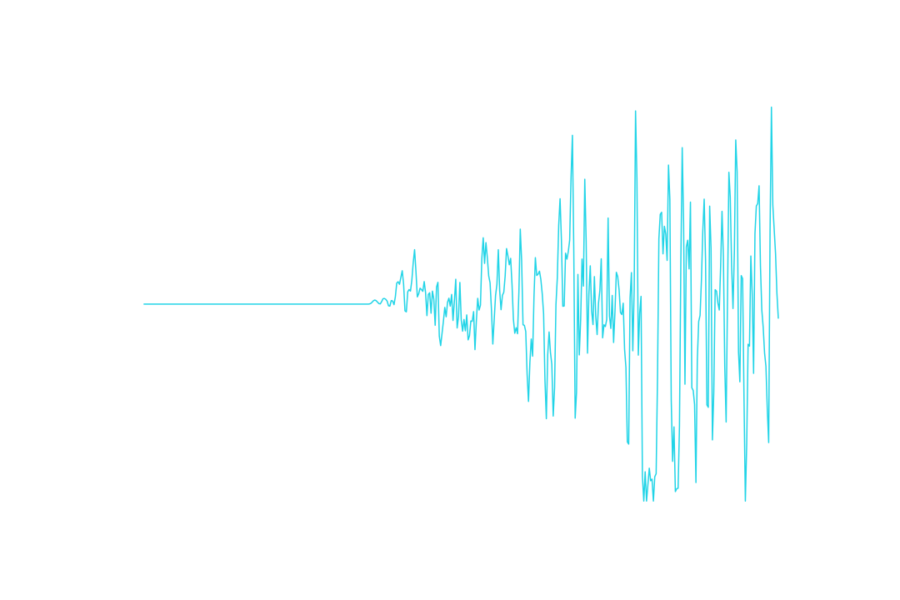
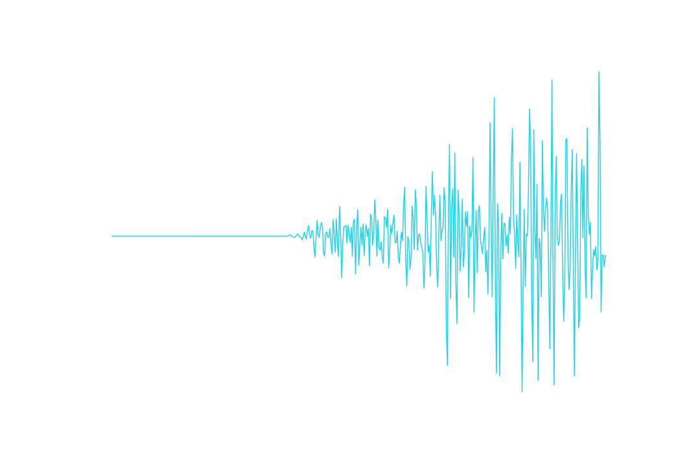
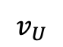
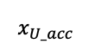
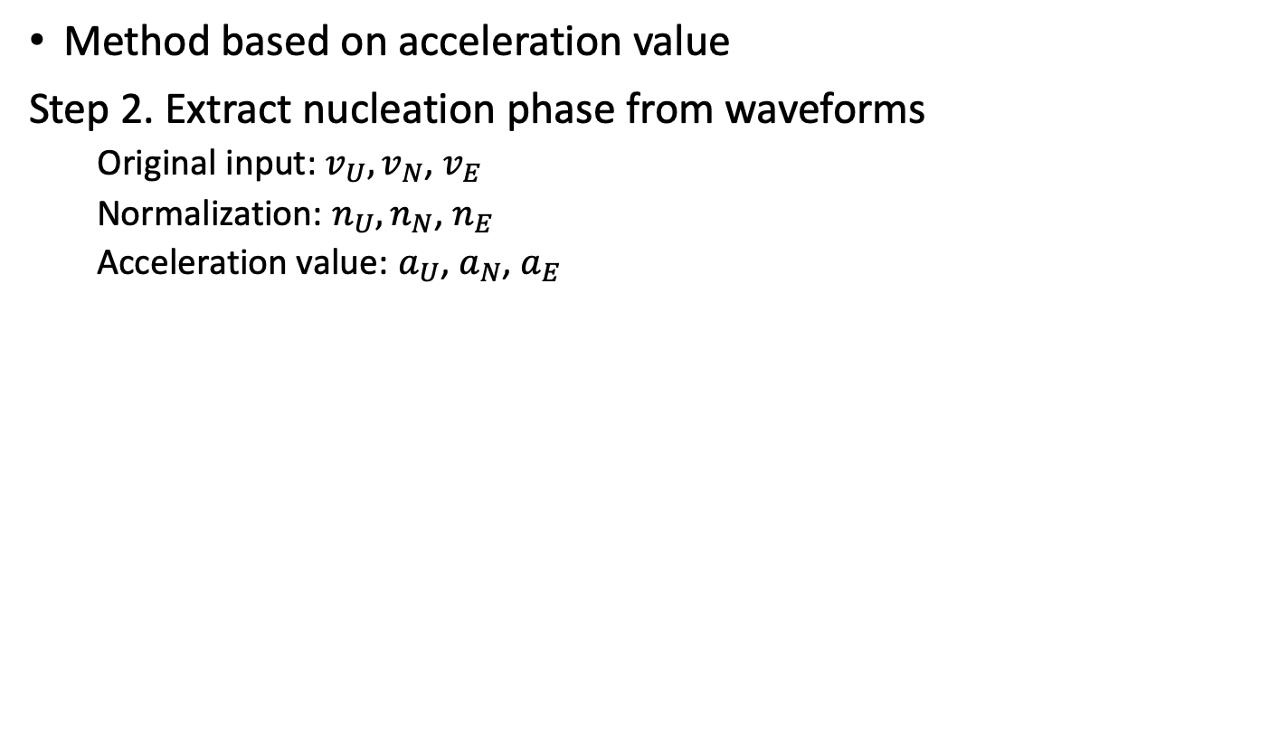
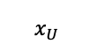

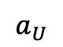
Dataset Generation
Method based on acceleration value
Step 2. Extract nucleation phase from waveforms
Original input: $v_{U},v_{N}$, $v_{E}$
Normalization: $n_{U},n_{N}$, $n_{E}$
Acceleration value: $a_{U}$, $a_{N}$, $a_{E}$
0.5 s
2.5 s
$$v_{U}$$
$$x_{U}$$
3 s
$$p$$
$$x_{U_acc}$$
$$a_{U}$$
First point >3 or <3
First point >3 or <-3
0.5 s
2.5 s

Slide 14
Dataset Generation
Method based on LTA/STA trigger algorithm
Step 1. Same as function based on acceleration value
Step 2. Because this algorithm needs a long-time segment to calculate average value, we apply it on one-minute length waveforms.
Sample rate: 100 points/second
Length of short time window: 5 sample rate
Length of long time window: 10 sample rate
Trigger threshold: 1.5

Slide 15
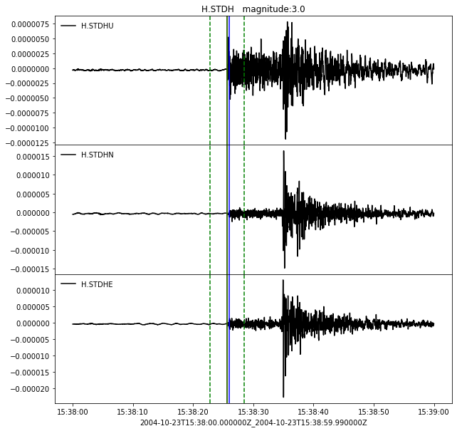
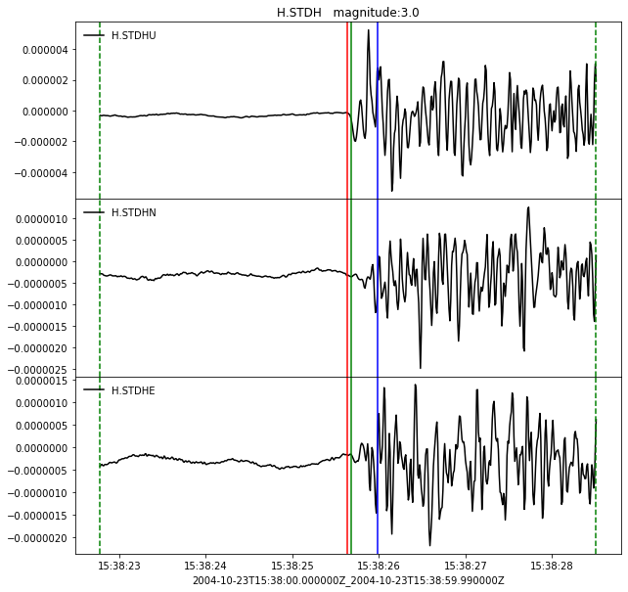
Dataset Generation
Comparison of Arrival Time of Seismic Waveforms
Zoom veiw
JMA arrival time data
Acceleration based method
Classic STA/LTA
Possible arrival range

Slide 16
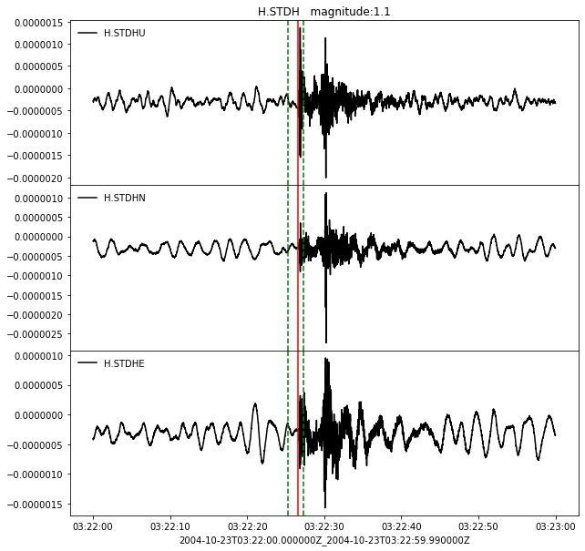
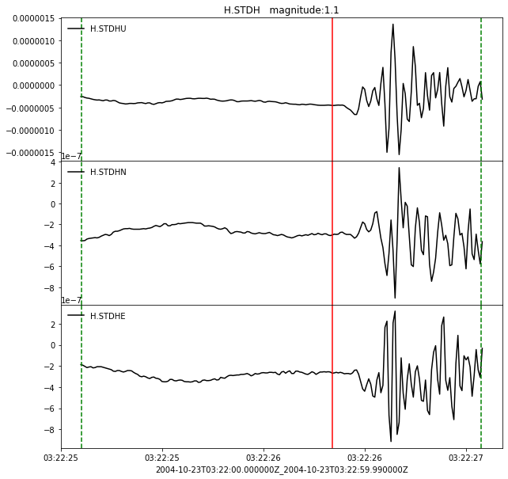
Dataset Generation
Comparison of Arrival Time of Seismic Waveforms
Zoom veiw
JMA arrival time data
Acceleration based method
Classic STA/LTA
Possible arrival range

Slide 17
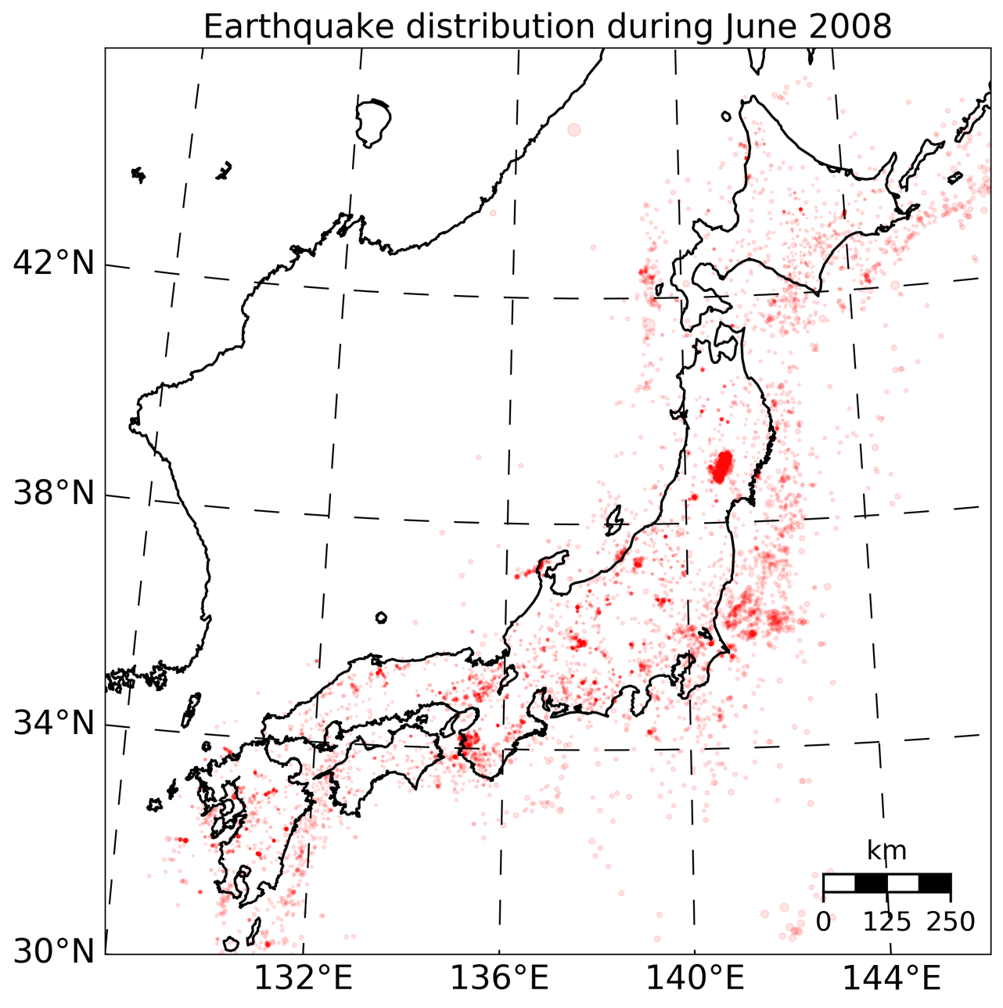
Dataset Generation
Data collected during June 2008
Earthquake epicenter distribution during June 2008.

Slide 18
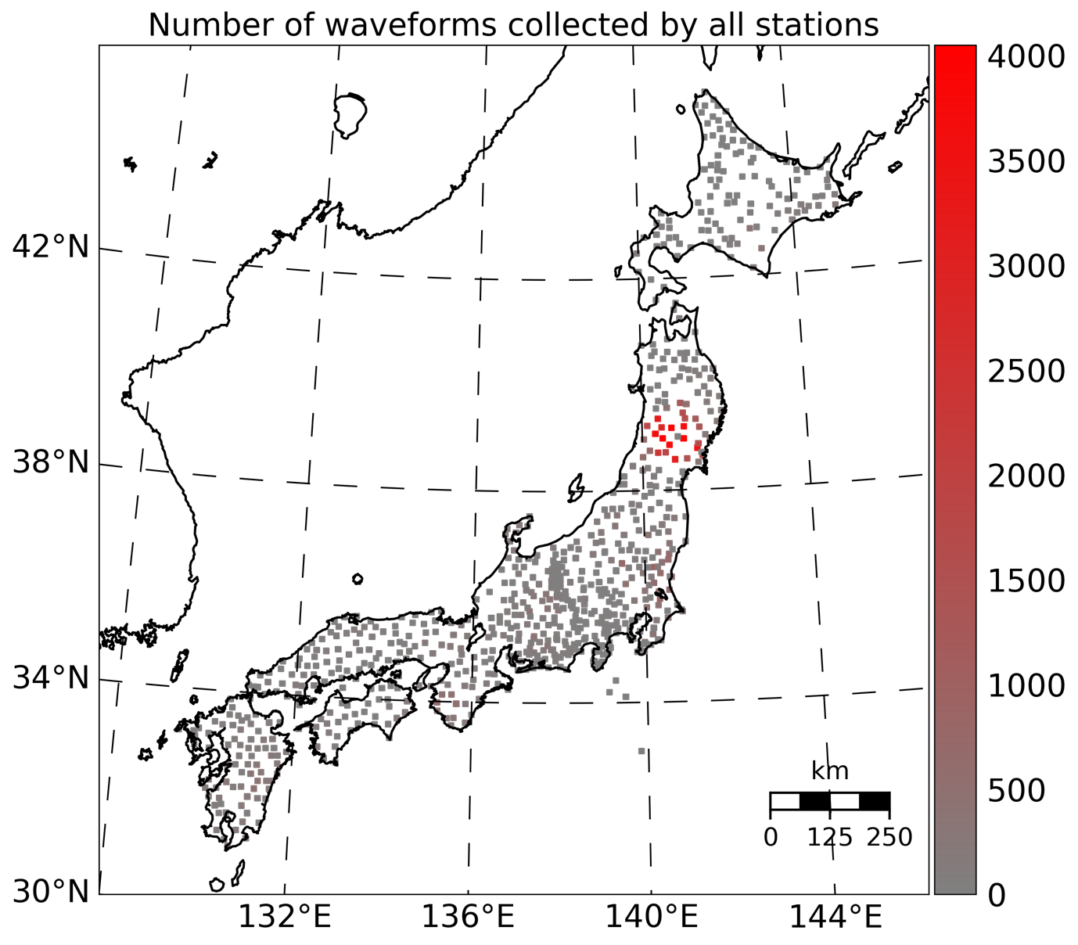
Dataset Generation
Data collected during June 2008
Number of events collected by every station.

Slide 19
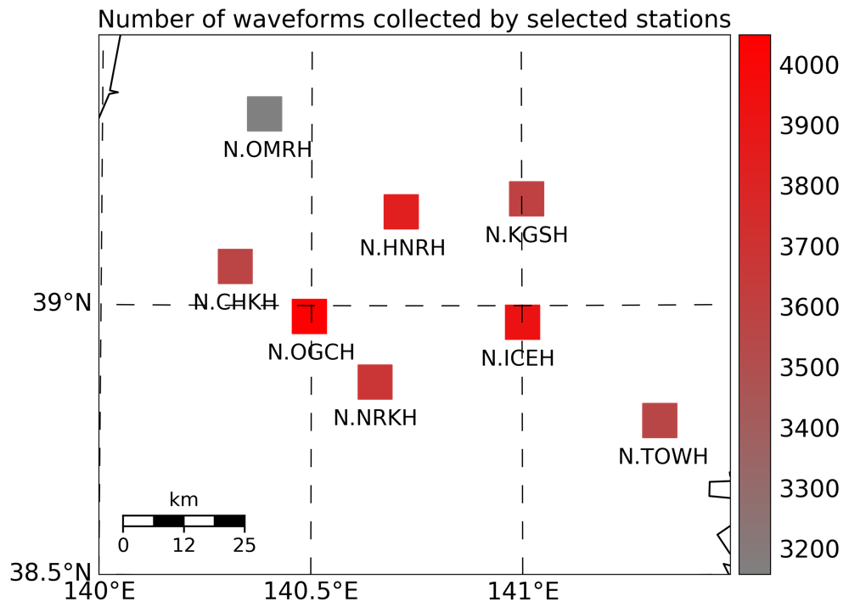
Dataset Generation
Data collected during June 2008
Stations with most events recorded during June 2008.

Slide 20
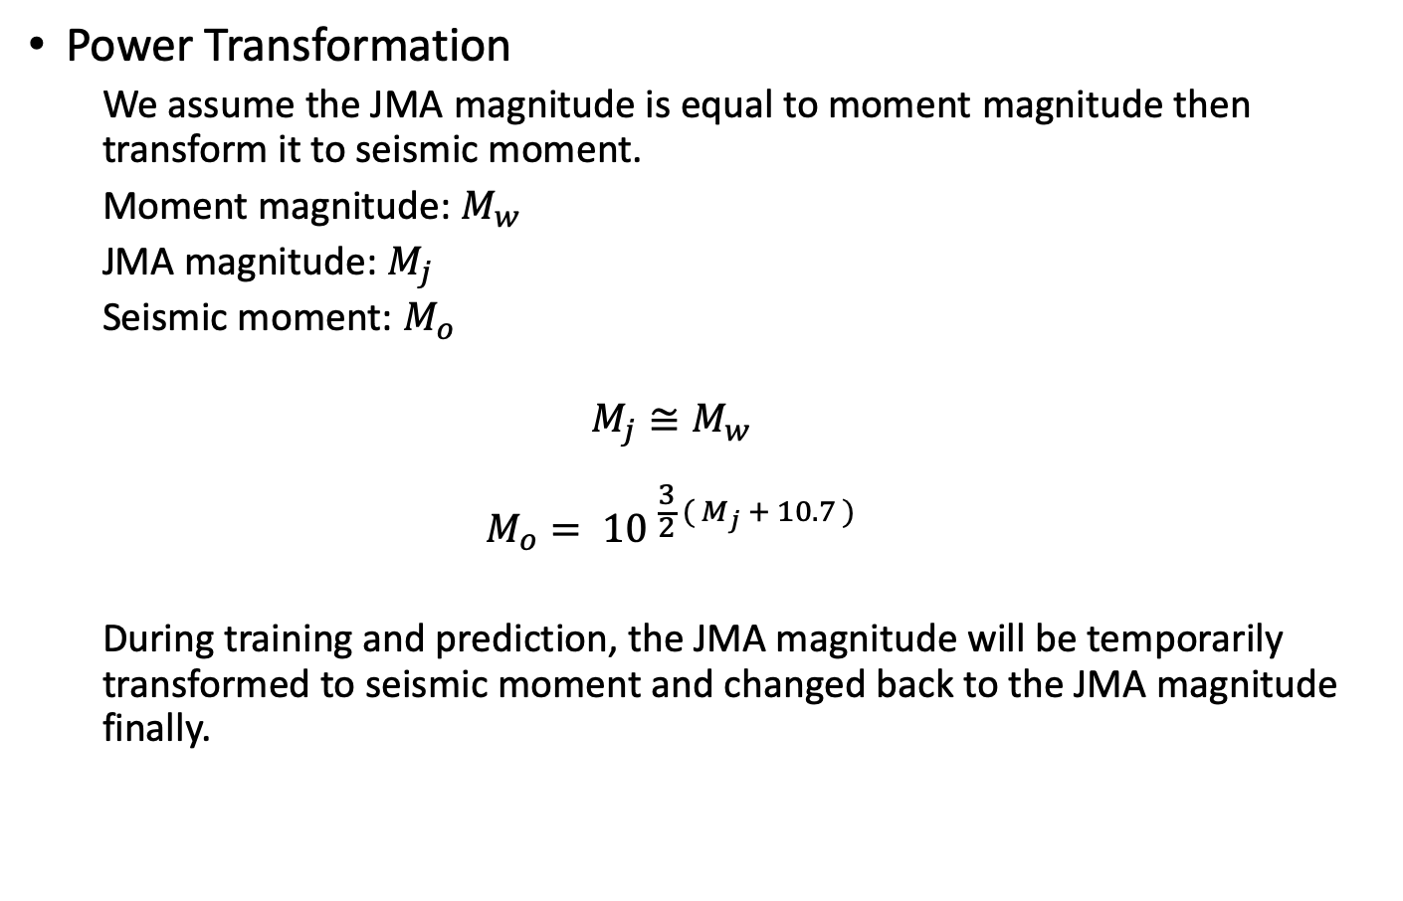
Training Process
Power Transformation
We assume the JMA magnitude is equal to moment magnitude then transform it to seismic moment.
Moment magnitude: $M_{w}$
JMA magnitude: $M_{j}$
Seismic moment: $M_{o}$
$$M_{j}≅M_{w}$$
$$M_{o}= {10 }^{\frac{3}{2} ( M_{j} + 10.7 )}$$
During training and prediction, the JMA magnitude will be temporarily transformed to seismic moment and changed back to the JMA magnitude finally.

Slide 21
Training Process
Models
MLP (multilayer perceptron)
1D CNN (convolutional neural network)
KNN (k nearest neighbors)

Slide 22
Training Process
Models – MLP
903 data points
Dataset
256 neurons
90%
10%
256 neurons Relu
Test set
80%
20%
256 neurons Relu
Seismic moment
Training set
Validation set

Slide 23
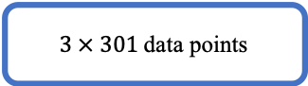
Training Process
Models – 1D CNN
$3 × 301$ data points
1D Convolutional: kernel size 50, filters number 128, activation tanh
Dataset
1D Convolutional: kernel size 50, filters number 128, activation tanh
90%
10%
Test set
Maxpooling 10
80%
20%
1D Convolutional: kernel size 3, filters number 64, activation tanh
Training set
Validation set
1D Global average pooling
Seismic moment

Slide 24
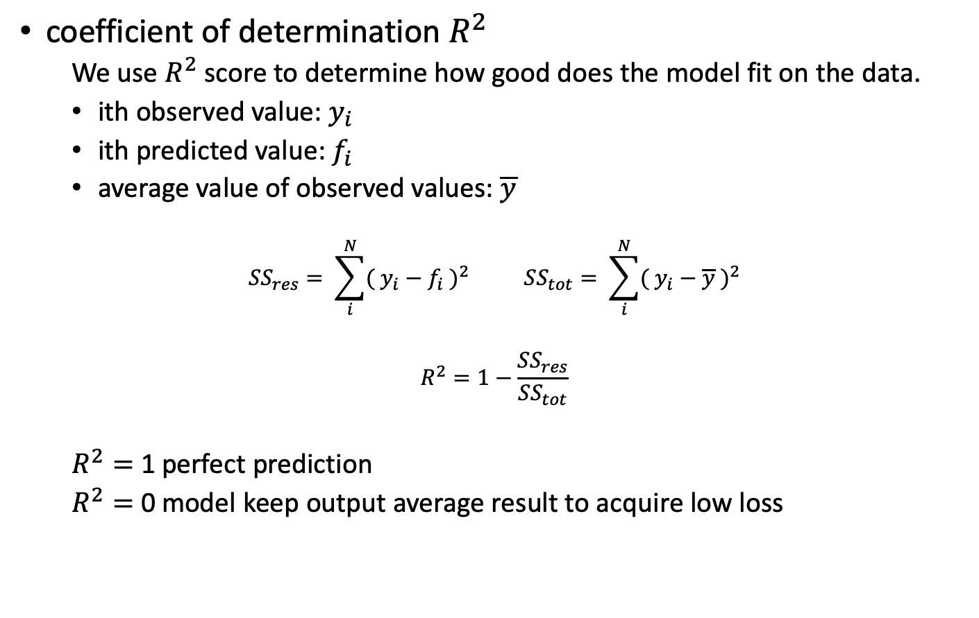
Results
coefficient of determination $R^{2}$
We use $R^{2}$ score to determine how good does the model fit on the data.
ith observed value: $y_{i}$
ith predicted value: $f_{i}$
average value of observed values: $\overline{y}$
$${SS}_{res}= \sum_{i}^{N}{{( y_{i}−f_{i} )}^{2}} {SS}_{tot}= \sum_{i}^{N}{{( y_{i}−\overline{y} )}^{2}}$$
$$R^{2}=1−\frac{{SS}_{res}}{{SS}_{tot}}$$
$R^{2}=$ 1 perfect prediction
$R^{2}=$ 0 model keep output average result to acquire low loss

Slide 25
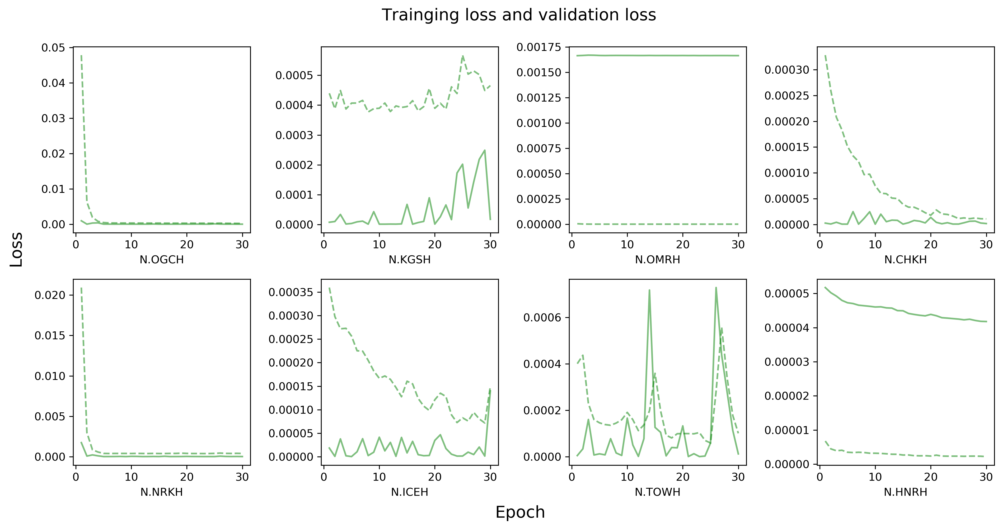
Results
Training loss
Validation loss
MLP
1D CNN
KNN (k=3)
KNN (k=5)
MLP

Slide 26
Results
Training loss
Validation loss
MLP
1D CNN
KNN (k=3)
KNN (k=5)
MLP
Training loss higher than validation loss

Slide 27
Results
Training loss
Validation loss
MLP
1D CNN
KNN (k=3)
KNN (k=5)
MLP
Loss increasing

Slide 28
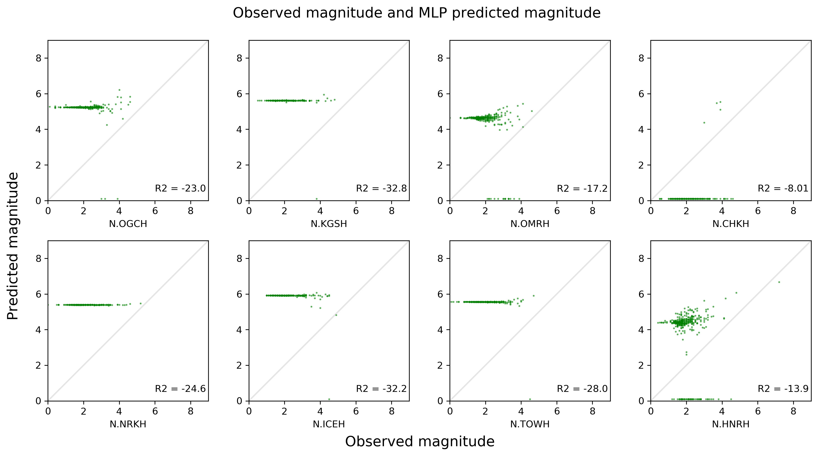
Results
Training loss
Validation loss
MLP
1D CNN
KNN (k=3)
KNN (k=5)
MLP

Slide 29
Results
Training loss
Validation loss
MLP
1D CNN
KNN (k=3)
KNN (k=5)
MLP
Prediction is nearly a straight line

Slide 30
Results
Training loss
Validation loss
MLP
1D CNN
KNN (k=3)
KNN (k=5)
MLP
Recognize some signals and try to approach correct results

Slide 31
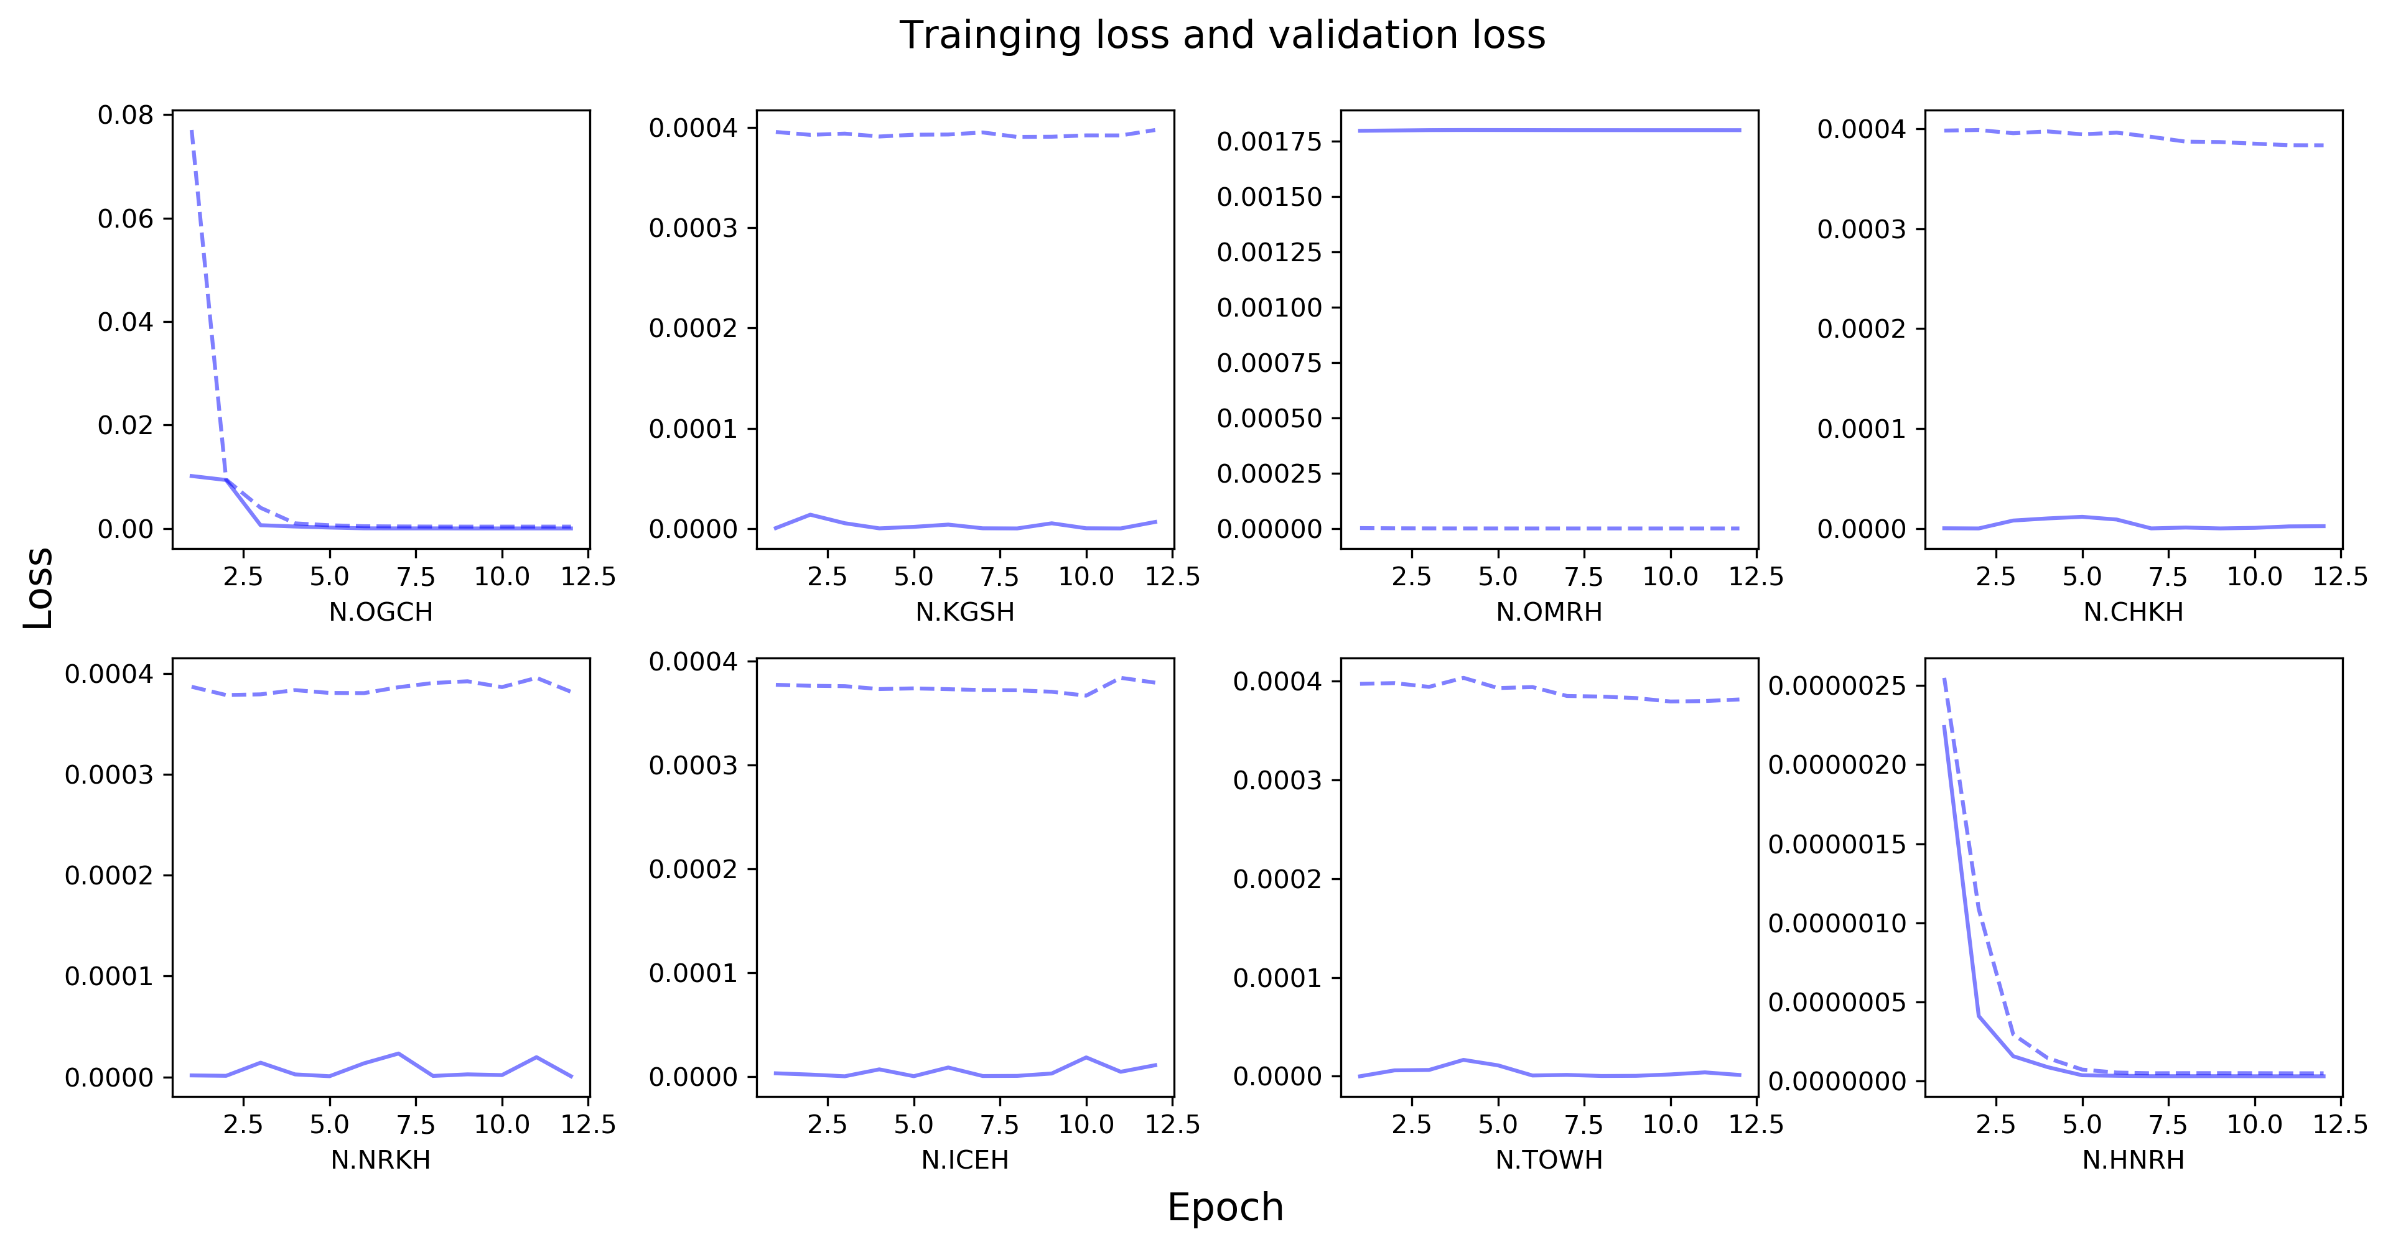
Results
Training loss
Validation loss
MLP
1D CNN
KNN (k=3)
KNN (k=5)
1D CNN

Slide 32
Results
Training loss
Validation loss
MLP
1D CNN
KNN (k=3)
KNN (k=5)
1D CNN
Training loss higher than validation loss

Slide 33
Results
Training loss
Validation loss
MLP
1D CNN
KNN (k=3)
KNN (k=5)
1D CNN
Training loss and validation loss are not changed

Slide 34
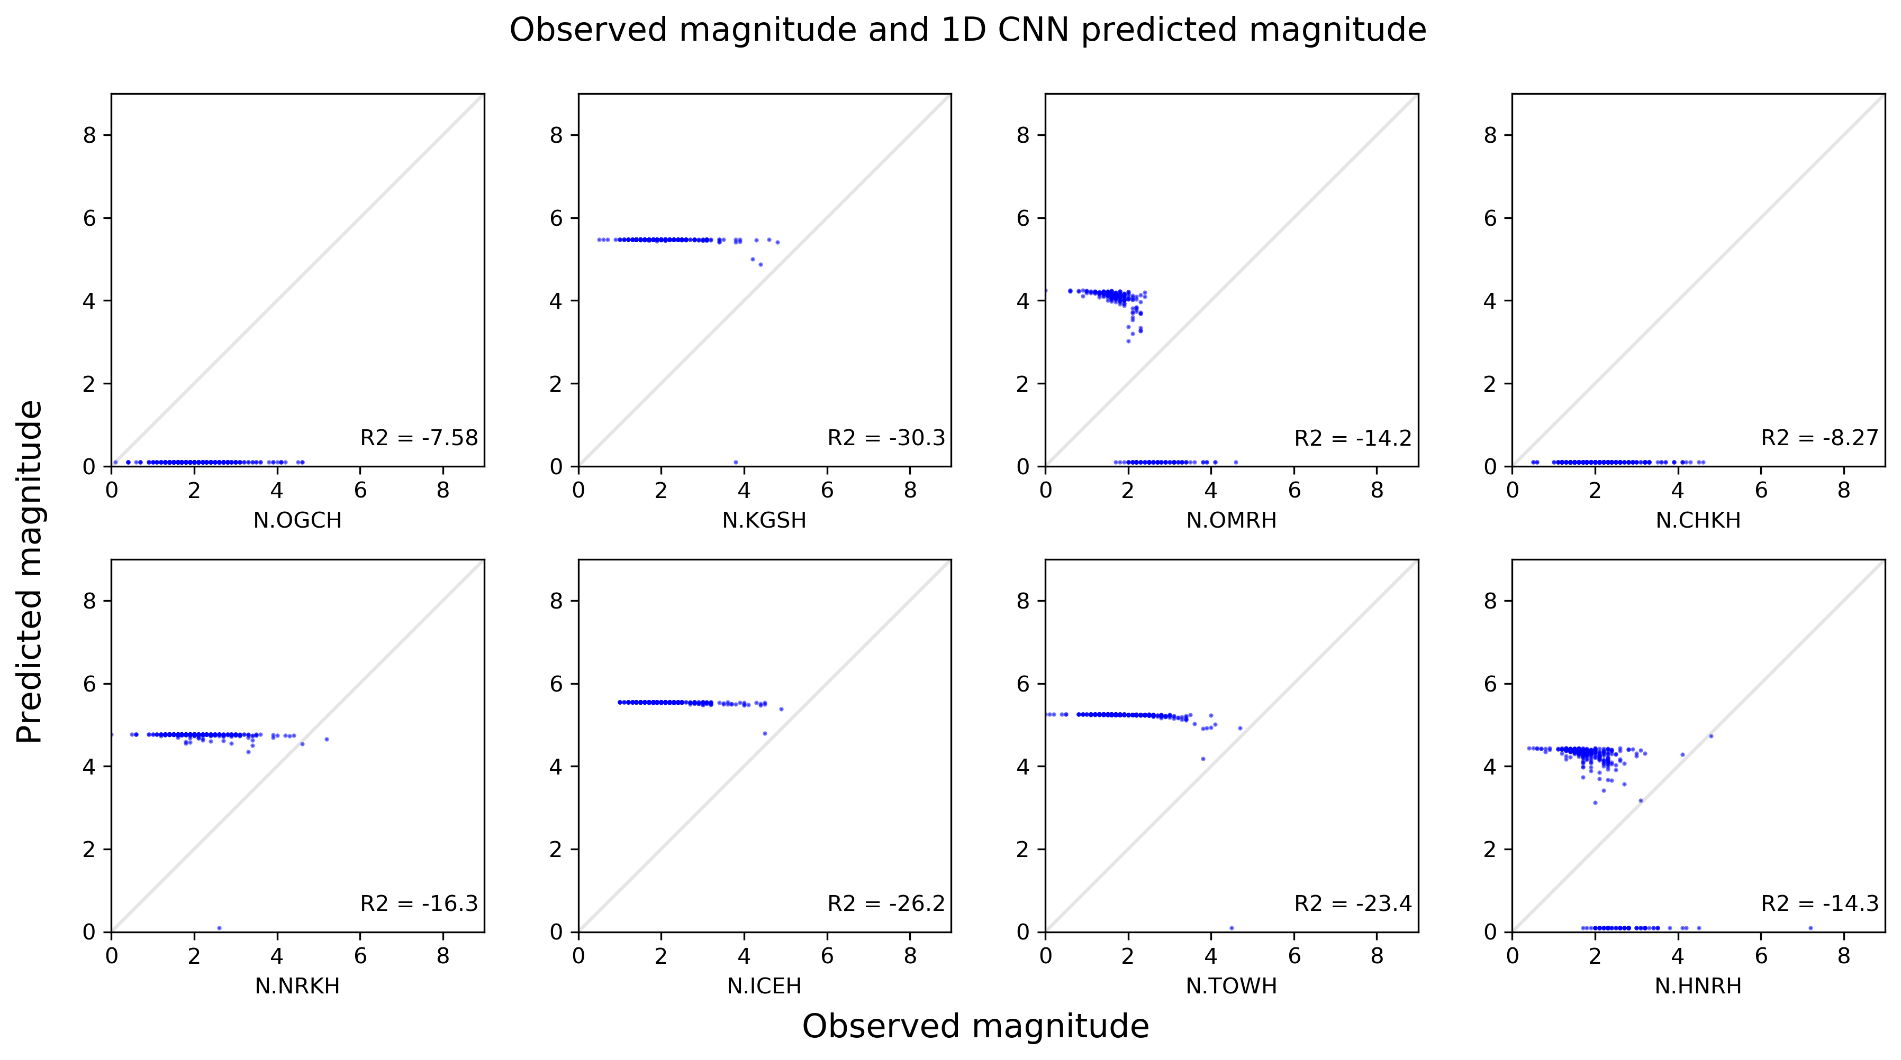
Results
Training loss
Validation loss
MLP
1D CNN
KNN (k=3)
KNN (k=5)
1D CNN

Slide 35
Results
Training loss
Validation loss
MLP
1D CNN
KNN (k=3)
KNN (k=5)
1D CNN
Prediction is nearly a straight line

Slide 36
Results
Training loss
Validation loss
MLP
1D CNN
KNN (k=3)
KNN (k=5)
1D CNN
Recognize some signals and try to approach correct results

Slide 37
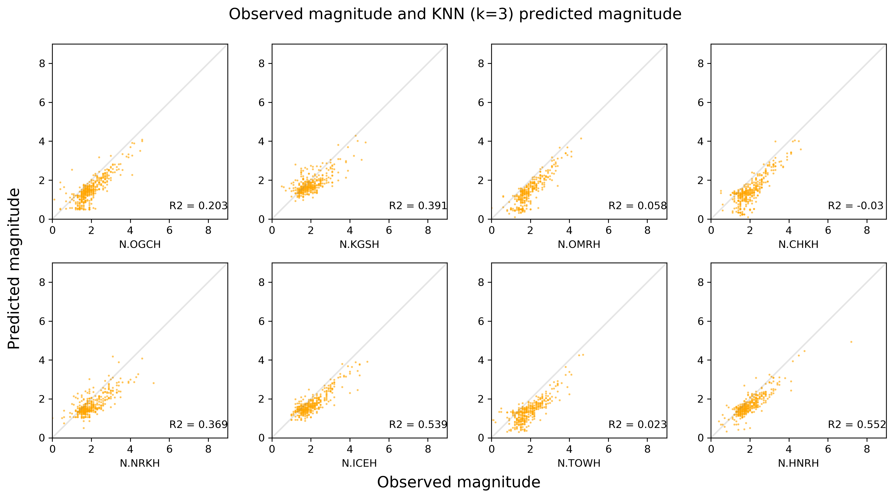
Results
Training loss
Validation loss
MLP
1D CNN
KNN (k=3)
KNN (k=5)
KNN (k=3)

Slide 38
Results
Training loss
Validation loss
MLP
1D CNN
KNN (k=3)
KNN (k=5)
KNN (k=3)
larger magnitude tends to be predicted smaller

Slide 39
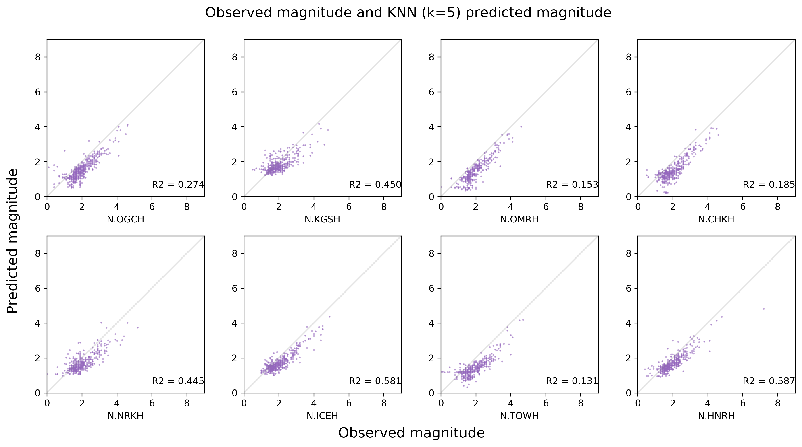
Results
Training loss
Validation loss
MLP
1D CNN
KNN (k=3)
KNN (k=5)
KNN (k=5)

Slide 40
Results
Training loss
Validation loss
MLP
1D CNN
KNN (k=3)
KNN (k=5)
KNN (k=5)
larger magnitude tends to be predicted smaller

Slide 41
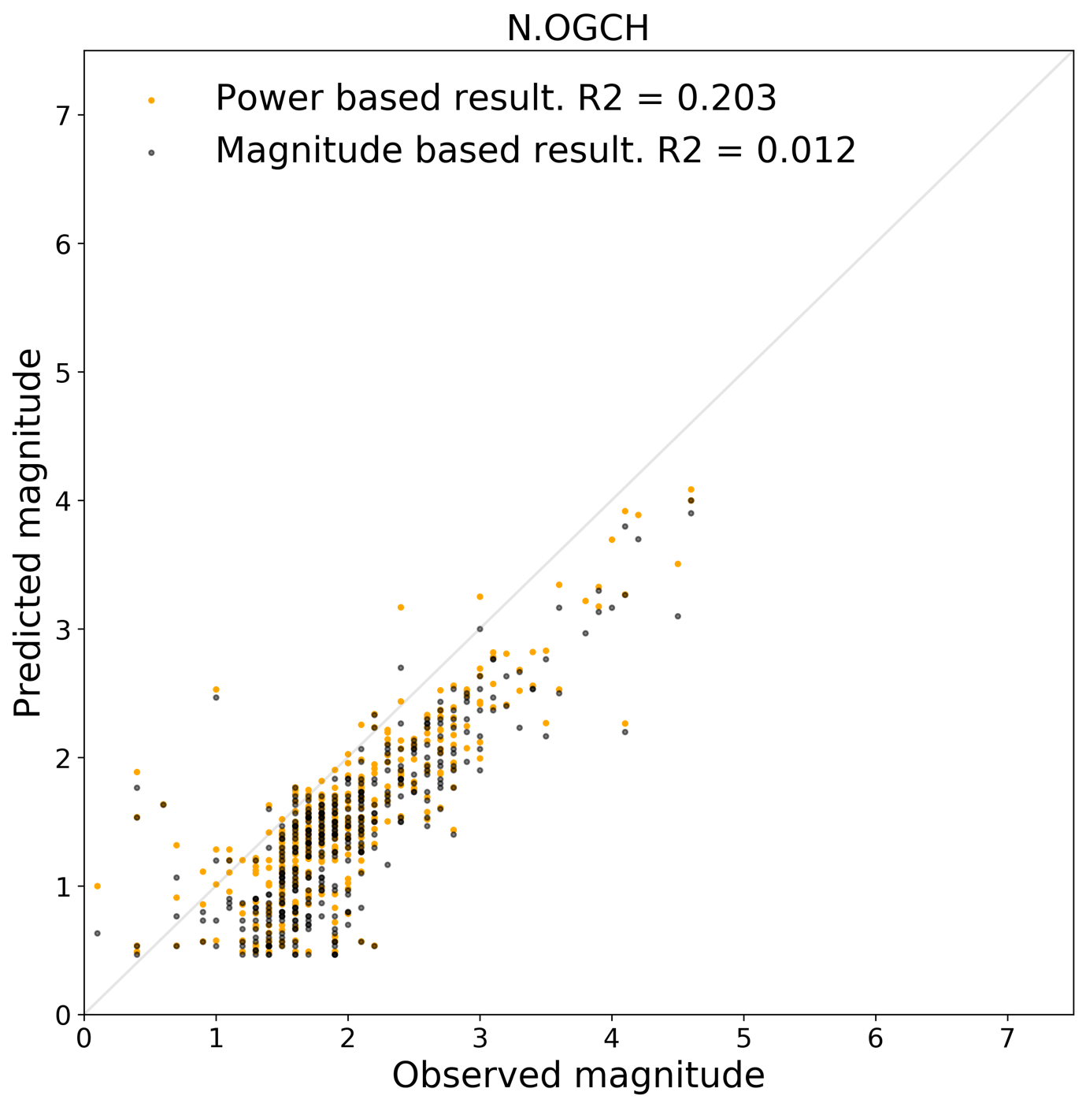
Results
Training loss
Validation loss
MLP
1D CNN
KNN (k=3)
KNN (k=5)
KNN
By transfer the JMA magnitude to seismic moment, this phenomenon had already fixed to some extent. Although two results look similar, results calculated with seismic moment are closer to the correct result.
Seismic moment based result. R2=0.203
JMA magnitude based result. R2=0.012

Slide 43
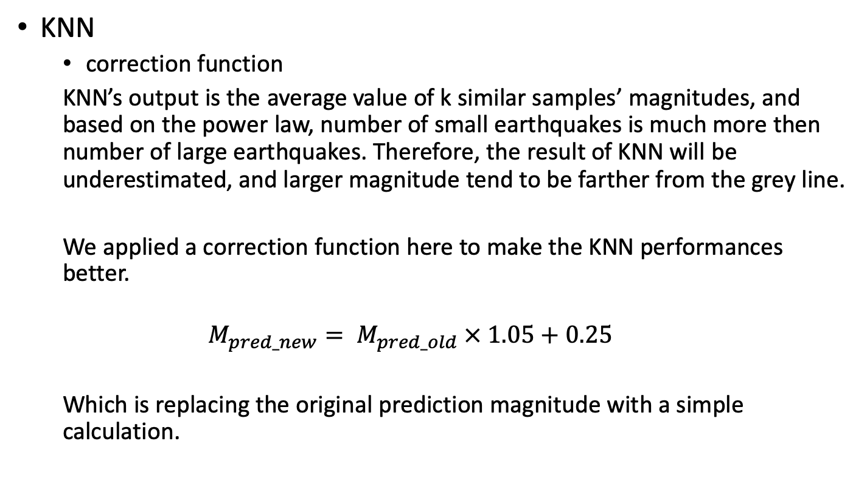
Results
KNN
correction function
KNN’s output is the average value of k similar samples’ magnitudes, and based on the power law, number of small earthquakes is much more then number of large earthquakes. Therefore, the result of KNN will be underestimated, and larger magnitude tend to be farther from the grey line.
We applied a correction function here to make the KNN performances better.
$$M_{pred_new}= M_{pred_old} × 1.05+0.25$$
Which is replacing the original prediction magnitude with a simple calculation.

Slide 44
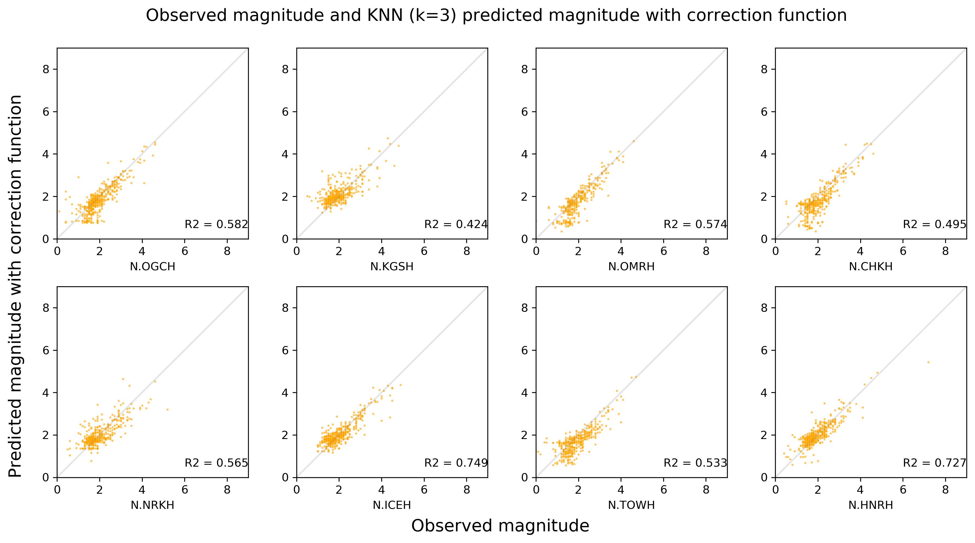
Results
Training loss
Validation loss
MLP
1D CNN
KNN (k=3)
KNN (k=5)
KNN (k=3)

Slide 45
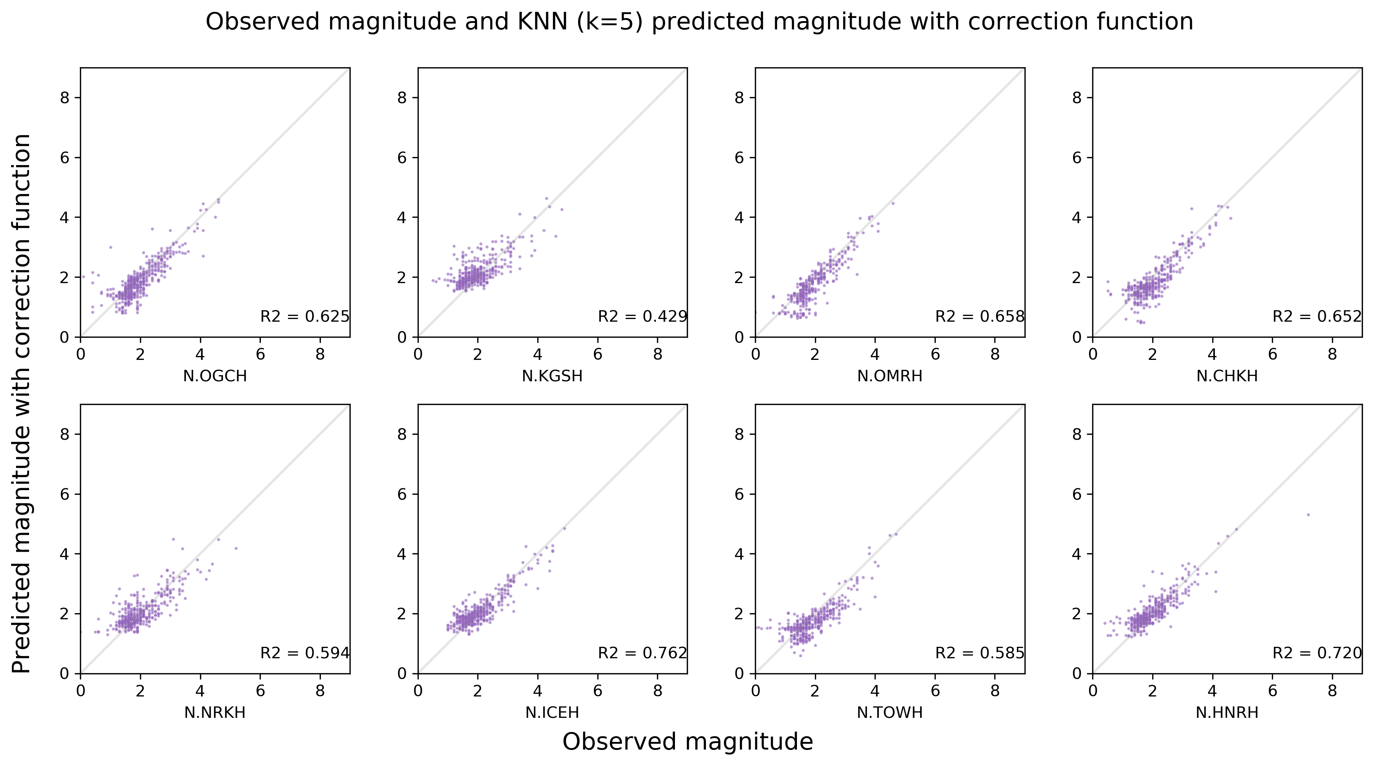
Results
Training loss
Validation loss
MLP
1D CNN
KNN (k=3)
KNN (k=5)
KNN (k=5)

Slide 46
Conclusions
The successful prediction of KNN also proves that the method we use to generate dataset are feasible. If we have better design for both structure and hyper-parameter, MLP and 1D CNN may also provide precise results.
The different performances between several models also give us a hint, is it possible that the reason of KNN’s better performance is how it operates? That is, nucleation phases collected from earthquakes with similar magnitudes are also similar to each other. The KNN’s algorithm just caters to this feature.
Considering the result of KNN, we may say that using the initial part of P-wave to predict magnitude is possible, this proves some evidence for the nucleation model.
However, small earthquakes usually have shorter nucleation phase than large ones, in some cases P-wave will end in three seconds. Therefore, we cannot completely deny the cascade model.

